Slide 1
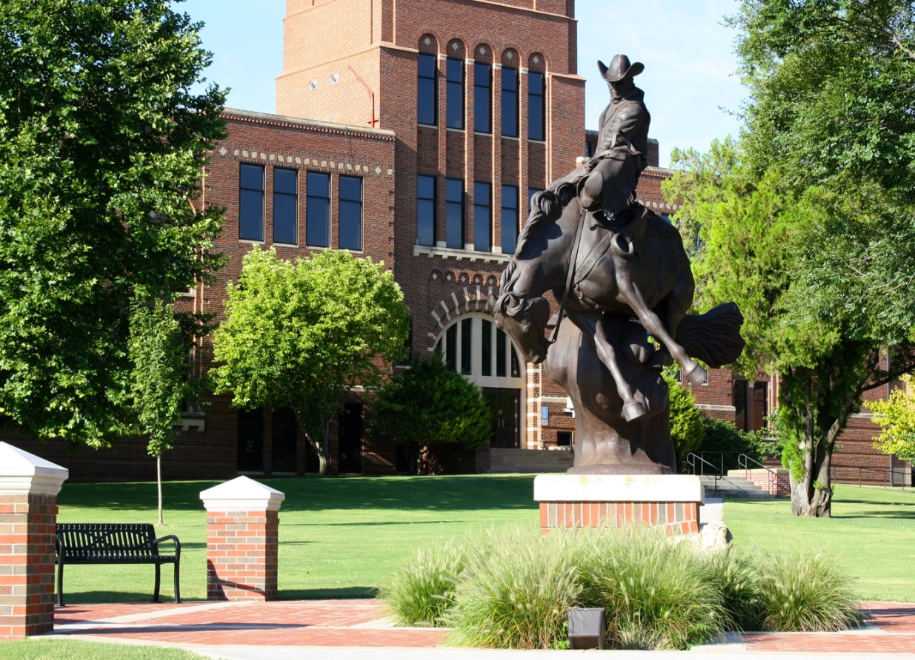
Ranger Nursing
April 2016

Slide 2
National Program Recognition
for 2015-2016

Slide 3
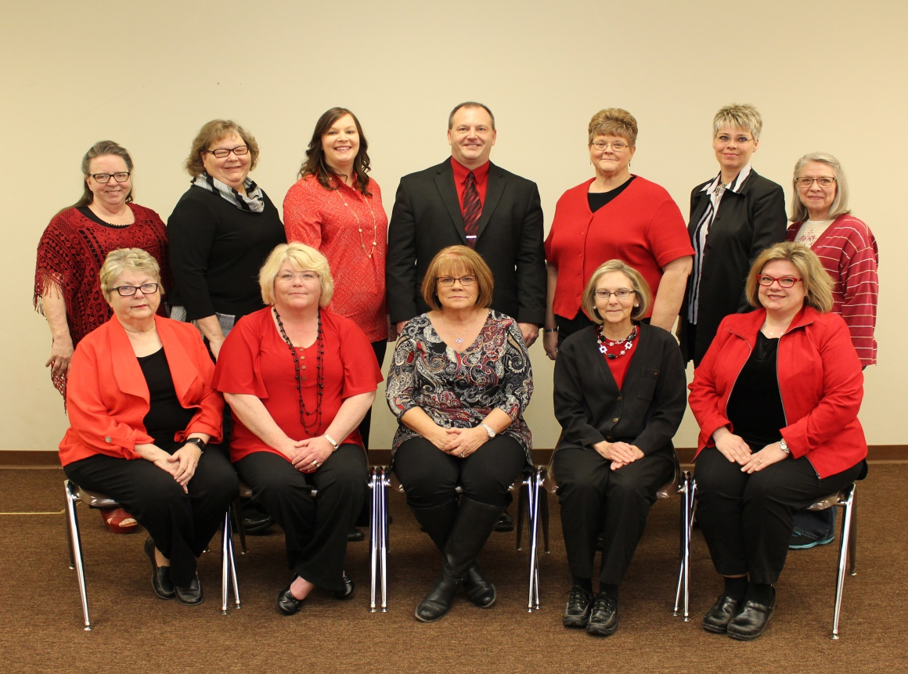
Faculty/Staff Profile
Six Full Time Faculty Doctorally Prepared
Remaining Faculty engaged in Doctoral Study
New Ketterman Lab Coordinator: Jean Wahlgren
Linda Banks – Secretary in Alva

Slide 4
Updates
Renovation of the Professional Practice Lab in Alva
Integration of simulation into the nursing curriculum
for both juniors and seniors.
Enhanced usage of ATI in curriculum to assess for
deficiencies and target remediation before NCLEX.
Individualized Performance Enhancement Plans
developed with every student to maximize their
strengths and guide towards success.
Increased usage of Ketterman Lab with clinical
partner in 2015-2016.

Slide 5
Summer MASH Camp
Held in collaboration with Northwest Technology Center
35 students (just finishing 6th grade) attended
the 2 ½ day experience focusing on health careers
Grant for Summer 2016 attained and will once again
recruit students from the Woods county area.

Slide 6
Graduates
Traditional Program: 33 in May 2015
Online RN-to-BSN: 10 in December 2015

Slide 7
Current Student Enrollment
Juniors: Total- 39
Alva – 17
Enid – 11
Woodward -6
Ponca City – 5
Seniors: Total - 34
Alva – 14
Enid – 11
Woodward – 6
Ponca City -3
Online RN-to-BSN: Total – 14
Summer 16 Grads – 6
December 16 Grads - 8
TOTAL NURSING STUDENTS
87

Slide 8
2016-17 Applicants
Traditional Program
35 Letters of Acceptance sent to Applicants
to start Summer 2016

Slide 9
Online RN-to-BSN Program
Admissions
Rolling acceptance:
2 accepted and 4 in cue
Application deadline June 30, 2016 for
Fall cohort
Now enrolling students every semester

Slide 10
Program Outcomes

Slide 11
Program Outcomes
2015 NCLEX Pass Rates
(percent by calendar year)
Alva - 73.3% (11/15 passed)
Enid – 100% (5/5 passed)
Woodward – 90% (9/10 passed)
Ponca City – 100% (1/1 passed)
Cumulative: 83.87%
2014 Cumulative: 76.92%

Slide 12
Program Outcomes
2015 Class and NCLEX:
NCLEX Pass Rate Report to OBN for Alva Campus
Of the 4 unsuccessful students-
2 were 2014 graduates
2 were delayed more than 3 months with NCLEX
There remain 2 graduates who have not tested

Slide 13
Program Outcomes
Ongoing NCLEX Improvement Actions:
Earlier VATI Start in 2015 with even earlier
VATI targets established for 2016 seniors
Continued faculty 1:1 work with at risk students
Goal: 2016 grads will have completed at least
50% of VATI before end of classes
VATI is a student-driven process.

Slide 14
Program Outcomes
2015 Graduate Surveys:
Overall Satisfaction with Educational Preparation = 1.45
Practice safely as a nursing generalist, using nursing process = 1.18
Utilize effective communication skills to engage in therapeutic relationships = 1.16
Job Placement – 66% secured position before graduation:
Enid – 10 Alva – 1 Woodward – 3
Ponca City -3 Seiling – 1 Buffalo – 1
Dodge City -1 Tulsa - 1
46 % planned to further formal education
Strengths of program: Faculty
Opportunities for Improvement: More clinical sites, traveling

Slide 15
Program Outcomes
Alumni Surveys
(6 months post graduation)
8 responses
88% are working full time nights in Med/Surg, OB or ER
88% plan to stay with current employer at least one more year
100% state employers’ expectations of my professional practice are in
agreement with the expectations voiced by NWOSU Nursing Faculty
75% view role as professional nurse differently now than did when graduating.
Comments:
“The holistic approach is probably the most beneficial thing I gained as well as how we
were taught to do assessments. My assessment skills coming out of college were better
than many nurses.”
“Capstone clinicals were the most helpful experiences”.
“Wish I had learned ACLS and NIH Stroke Assessment”

Slide 16
Program Outcomes
Alumni Surveys
(2012 grads)
1 response
Working in NYC in a Laser Skin Surgery Center
“Our work in Evidence Based Practice makes it easier to implement new
policies and regulations in the workplace. Also being trained to connect with
patients helps you be an effective advocate for them”.
“We had no real training in areas such as dermatology, but I still don’t
feel like I had a deficit. Just a little overwhelmed at first. Skin cancer
surgeries are my favorite.”

Slide 17
Program Outcomes
Employer Surveys:
Sent out 27 survey links using Survey Monkey
Received ONE response with mean scores
of 1.0 on all criteria

Slide 18
Program Outcomes
Facility Evaluation of Student Clinical Experiences
Received 18 responses from 10 facilities
Objectives, expectations and schedules are communicated in advance (1.43)
Facility policies and procedures followed (1.31)
Significant patient data communicated to staff (1.51)
Nursing staff aware of their roles in student experience (1.52)
Staff comfortable sharing in instruction process with faculty/students (1.35)
Students work collaboratively with staff to meet patient needs (1.43)
Students/faculty receptive to feedback from facility staff (1.31)
Likert Scale: 1= Very Satisfied 5 = Strongly Dissatisfied

Slide 19
Still to come….
Continue to improve the NCLEX pass rate
issue and timeliness of grads in taking exam
Curriculum mapping to the 2016 NCLEX Test Plan
Explore establishing relationship with Vance Medical Wing
Seek national accreditation through CCNE
(Commission on Collegiate Nursing Education)
Change in Administrative Structure at NWOSU
BSN to DNP Family Nurse Practitioner Program

Slide 20
BSN to DNP
Family Nurse Practitioner Program
Fully funded program to admit first
students in Fall 2017
Three year program with 73 credits and 1020
clinical practicum hours
Grads will be eligible for FNP certification
and APRN licensure in Oklahoma
Program allows students to bypass the MSN
Degree completion component for FNPs
with MSN

