Slide 1
Institutional Assessment Plans

Slide 2
Tasks to Complete
Institutional Assessment 2016-2017 with Results (LiveText)
  Goals, Methodologies, and Success Measures should already be complete.
  Results of Goals, Budget Implications, and Internal External Reporting need to be completed.
Institutional Assessment 2017-2018 (ALCA)
  Goals, Strategic Directions, Methodologies, and Success Measures only

Slide 3
Due Date
Plans are due September 11th!
You will receive SEVERAL reminders before assignments are due.

Slide 4
ALCA
Step-by-Step Instructions

Slide 5
ALCA
https://arch.alcaweb.org/tool/login
Login information
  Director of A & IE keeps all passwords on file. If you change yours, please inform Brooke Fuller.

Slide 6
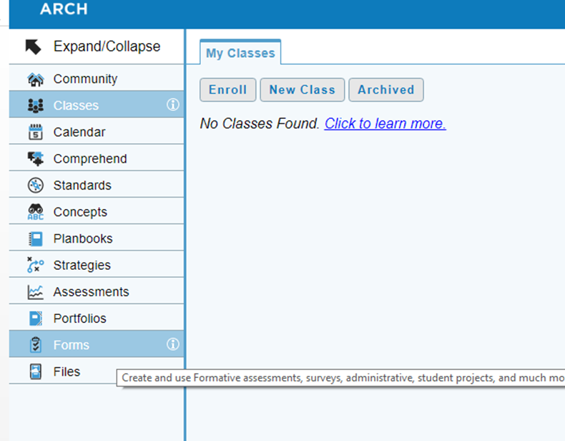
Select “Forms” on the left hand side of the page.

Slide 7
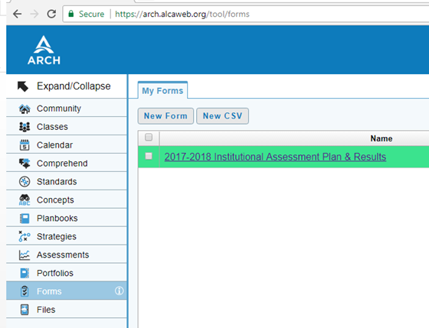
Locate your “2017-2018 Institutional Assessment Plan & Results” form. Click on the title of the form (not the box to the left).

Slide 8
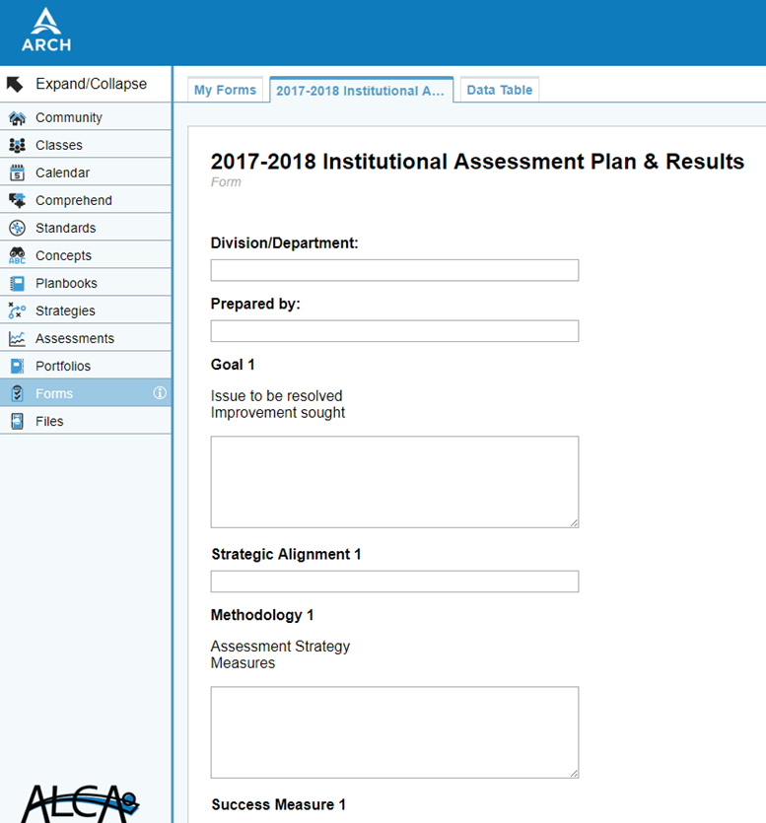
Complete the form!

Slide 9
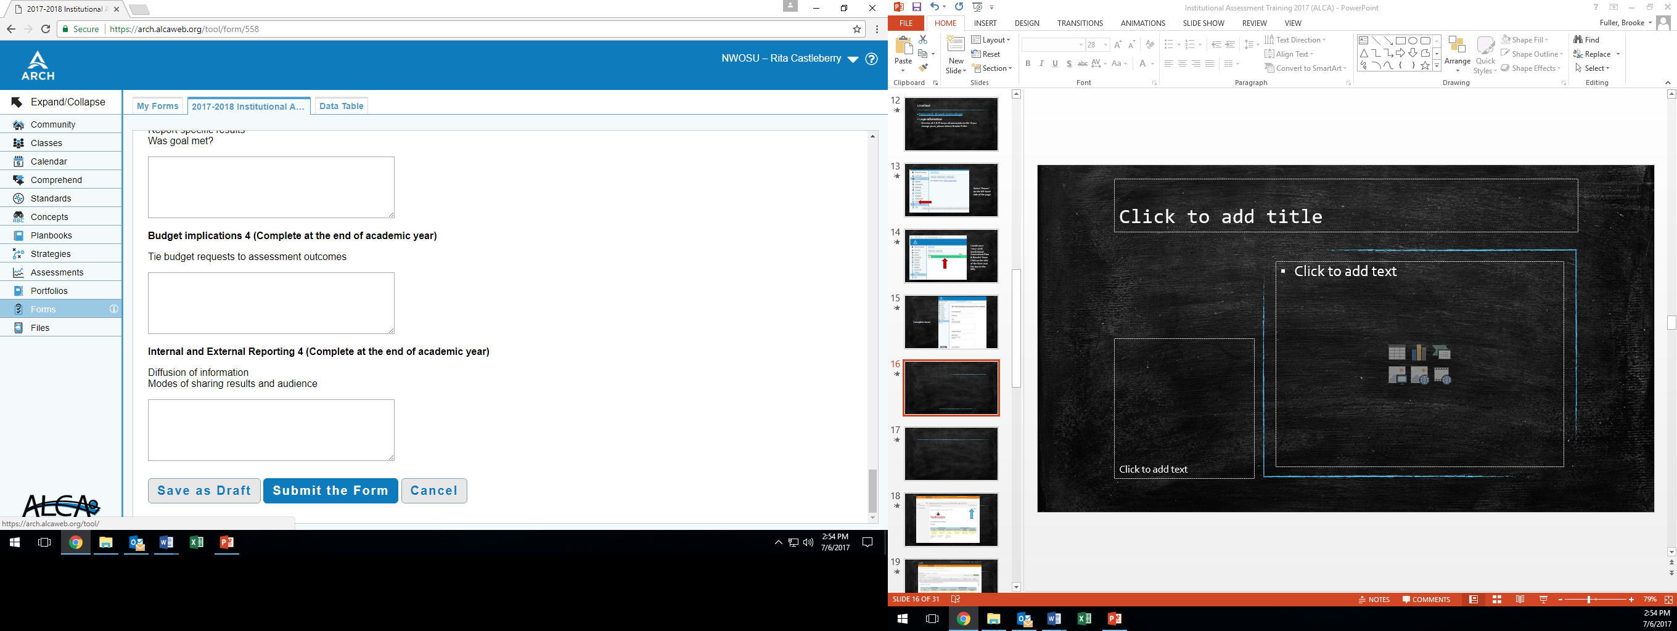
Select “Submit the Form” when you are finished.

Slide 10
Helpful Tips

Slide 11
Goals
Each department should have FOUR goals.
  What are my main projects/goals this year?
  What areas need improvement?
  What areas did my department score poorly on during the last satisfaction survey?
  Common words to use: adapt, complete, create, develop, enhance, establish, improve, implement, increase, initiate, modify, produce, replace, revise, rewrite.
Example
  Improve and clarify the process of disseminating assessment results to the NWOSU community.

Slide 12
Strategic Direction
Use Strategic Plan to help guide goals.
Each goal SHOULD tie back to the Strategic Plan.
Strategic Plan 2016-2021: http://www.nwosu.edu/Websites/NWOSU/images/StrategicPlan/2016StrategicPlanfinal.pdf
Example
  Strategic Direction 1 & 2

Slide 13
Methodology
Plan of action
What will you do to achieve this goal?
Example
  How will I improve the process of dissemination of assessment results?
    Develop an assessment newsletter that will be delivered once per semester reporting various assessment results.
    Utilize the A & IE website to post results online.

Slide 14
Success Measures
Establish the criteria that will be used to determine success.
BE SPECIFIC!
  Use numbers, dates, amounts, percentages, etc.
Example
  Director of A & IE will send newsletter via email to 100% of the NWOSU community in November and April.
  Director of A & IE will create a brief summary after each survey or assessment and post it on the A & IE website within two weeks of assessment/survey end date.

Slide 15
Results of Goal
Report results
  Was your goal met?
  How do you know?
Be specific! Use numbers, dates, amounts, percentages, etc.
Example
  Director of A & IE sent newsletter to 100% of the NWOSU community in November 2014 and May 2015.
  The results of the following surveys and assessments were posted to the assessment website: 2013-2014 Alumni Survey, 2012-2015 ETS PP, 2011-2014 NSSE, and 2014-2015 Staff Satisfaction

Slide 16
Budget Implications
What were the costs (labor resources, materials, etc.) needed to help reach the goal, if any?
If no budget implications, please answer with “None.” Do not leave blank.

Slide 17
Internal and External Reporting
Who did you tell?
How was the information disseminated?
Reports, meetings, committees, emails, news releases, etc.
Example
  Information reported to Executive Vice President
  Information reported to Assessment and Institutional Effectiveness committee
  Annual Report

Slide 18
Questions or Comments?

